Slide 1
First steps to go ahead with MS SQL Server on Linux

Slide 2

Hello!
I am Geo Hernandez
Database Engineer and Microsoft Certified Trainer with fifteen years of experience. I have worked in databases areas like performance tuning, optimization, and unit testing. I have plenty of experience in relational databases like MS SQL Server and MySQL as well in NoSQL like Cassandra.

Slide 3
AGENDA
Why SQL Server on Linux? Linux Distros
Basic Linux commands
Installing SQL Server on Linux
Deploying our first SQL Server Database
Cleaning the house
Resources

Slide 4


Why SQL Server on Linux?

Slide 5

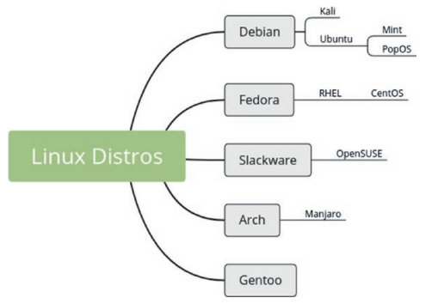


Linux Distros
Credits: Philip Kirkbride / Basic Linux Terminal Tips and Tricks

Slide 6
Basic Linux Commands
ls and ll: List out files in a directory. The ls has many type of options to list out files. ll is aliased to 'ls -l' , it provides a detailed list of a directory or a file(s) including size, permission, and date/time.
grep: Global regular expression parser command to return lines matching a pattern or basically to search text and regular expressions in the provided input. Example: ps -ef | grep sql

Slide 7
man: Short for “manual pages.” Allow us to get help about commands, example: man ps
pwd: This stands for “print working directory” and bring you the current working directory.
ps: This stands for process status and it gets a list of processes running on the Linux server and details about them.
https://geohernandez.net/linux-basic-commands-for-sql-server-developers/
https://www.mssqltips.com/sqlservertip/4816/top-10-linux-commands-for-sql-server-dbas/

Slide 8


Setting up – SQL SERVER ON LINUX
Memory 2 GB
File System XFS or EXT4 (other file systems, such as BTRFS, are unsupported)
Disk space 6 GB
Processor speed 2 GHz
Processor cores 2 cores
Processor type x64-compatible only

Slide 9

Installing SQL server on Linux

Slide 10


Slide 11


DEMO TIME Installing SQL Server on

Slide 12
DEMO TIME Installing SQL Server on

Slide 13


Connecting to sql server
Inbound security rules (in Azure VM)
Open up port 1433(only RHEL).

Slide 14

Deploying our first sql server database and cleaning the house

Slide 15
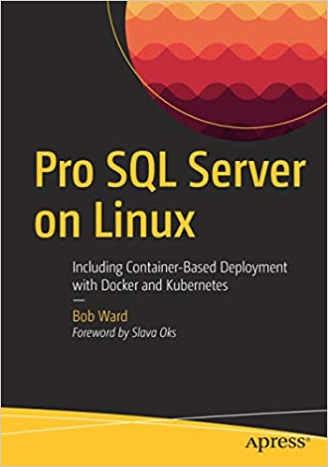


Resources
Books:
Courses:

Slide 16

Thanks!
Any questions?
You can find me at @datawithgeo
& hi@geohernandez.net

